Slide 1
Real Steel 鋼鐵擂台
Embedded System Lab (Fall 2016)
Chien-Sheng Wu 吳建昇, Yuan-Ting Hsieh 謝沅廷

Slide 2
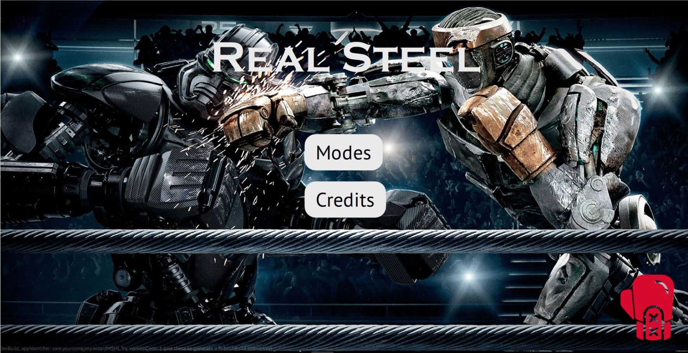

Slide 3
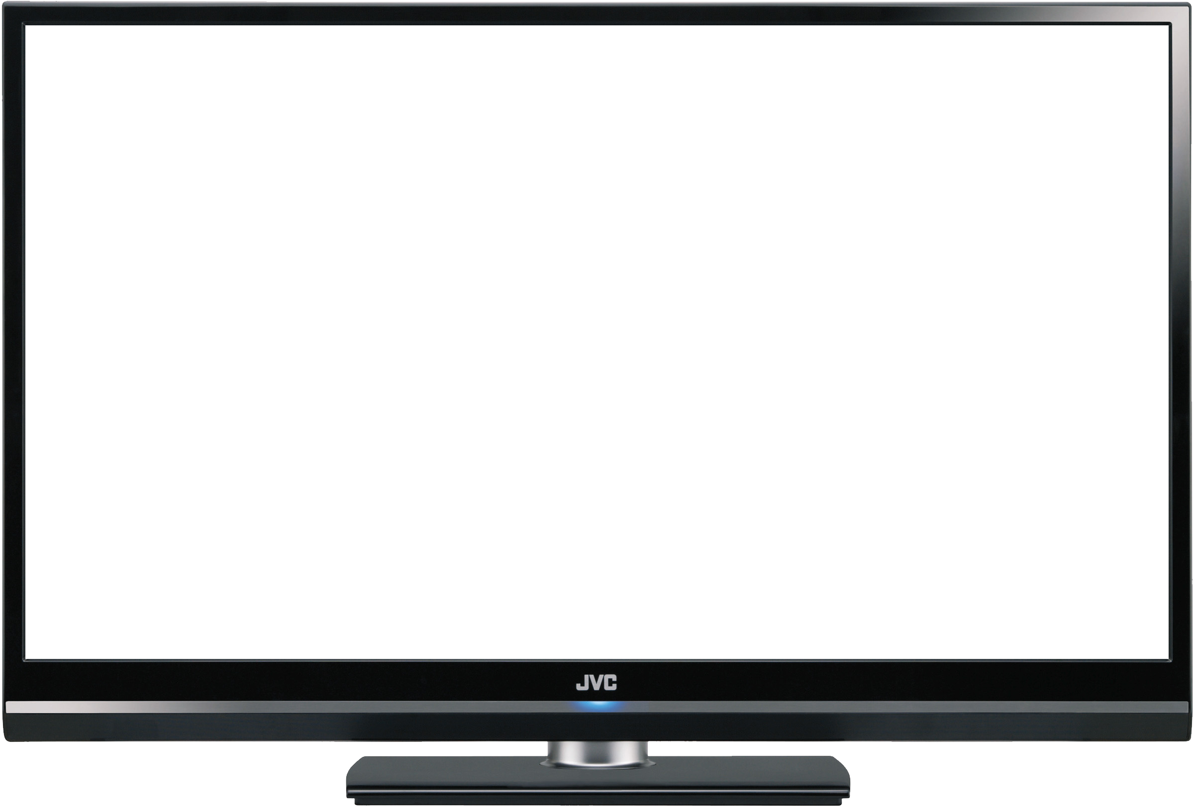
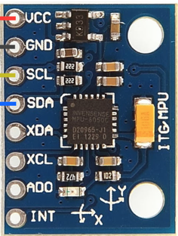
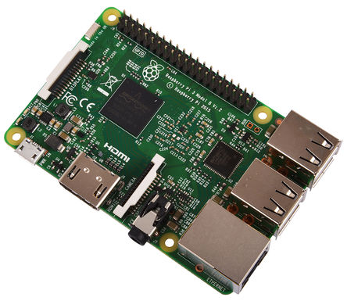
System Block Diagram
Qt GUI
I2C
I2C
Socket
I2C
I2C
BlueTooth
BlueTooth
Player 1
Player 2

Slide 4
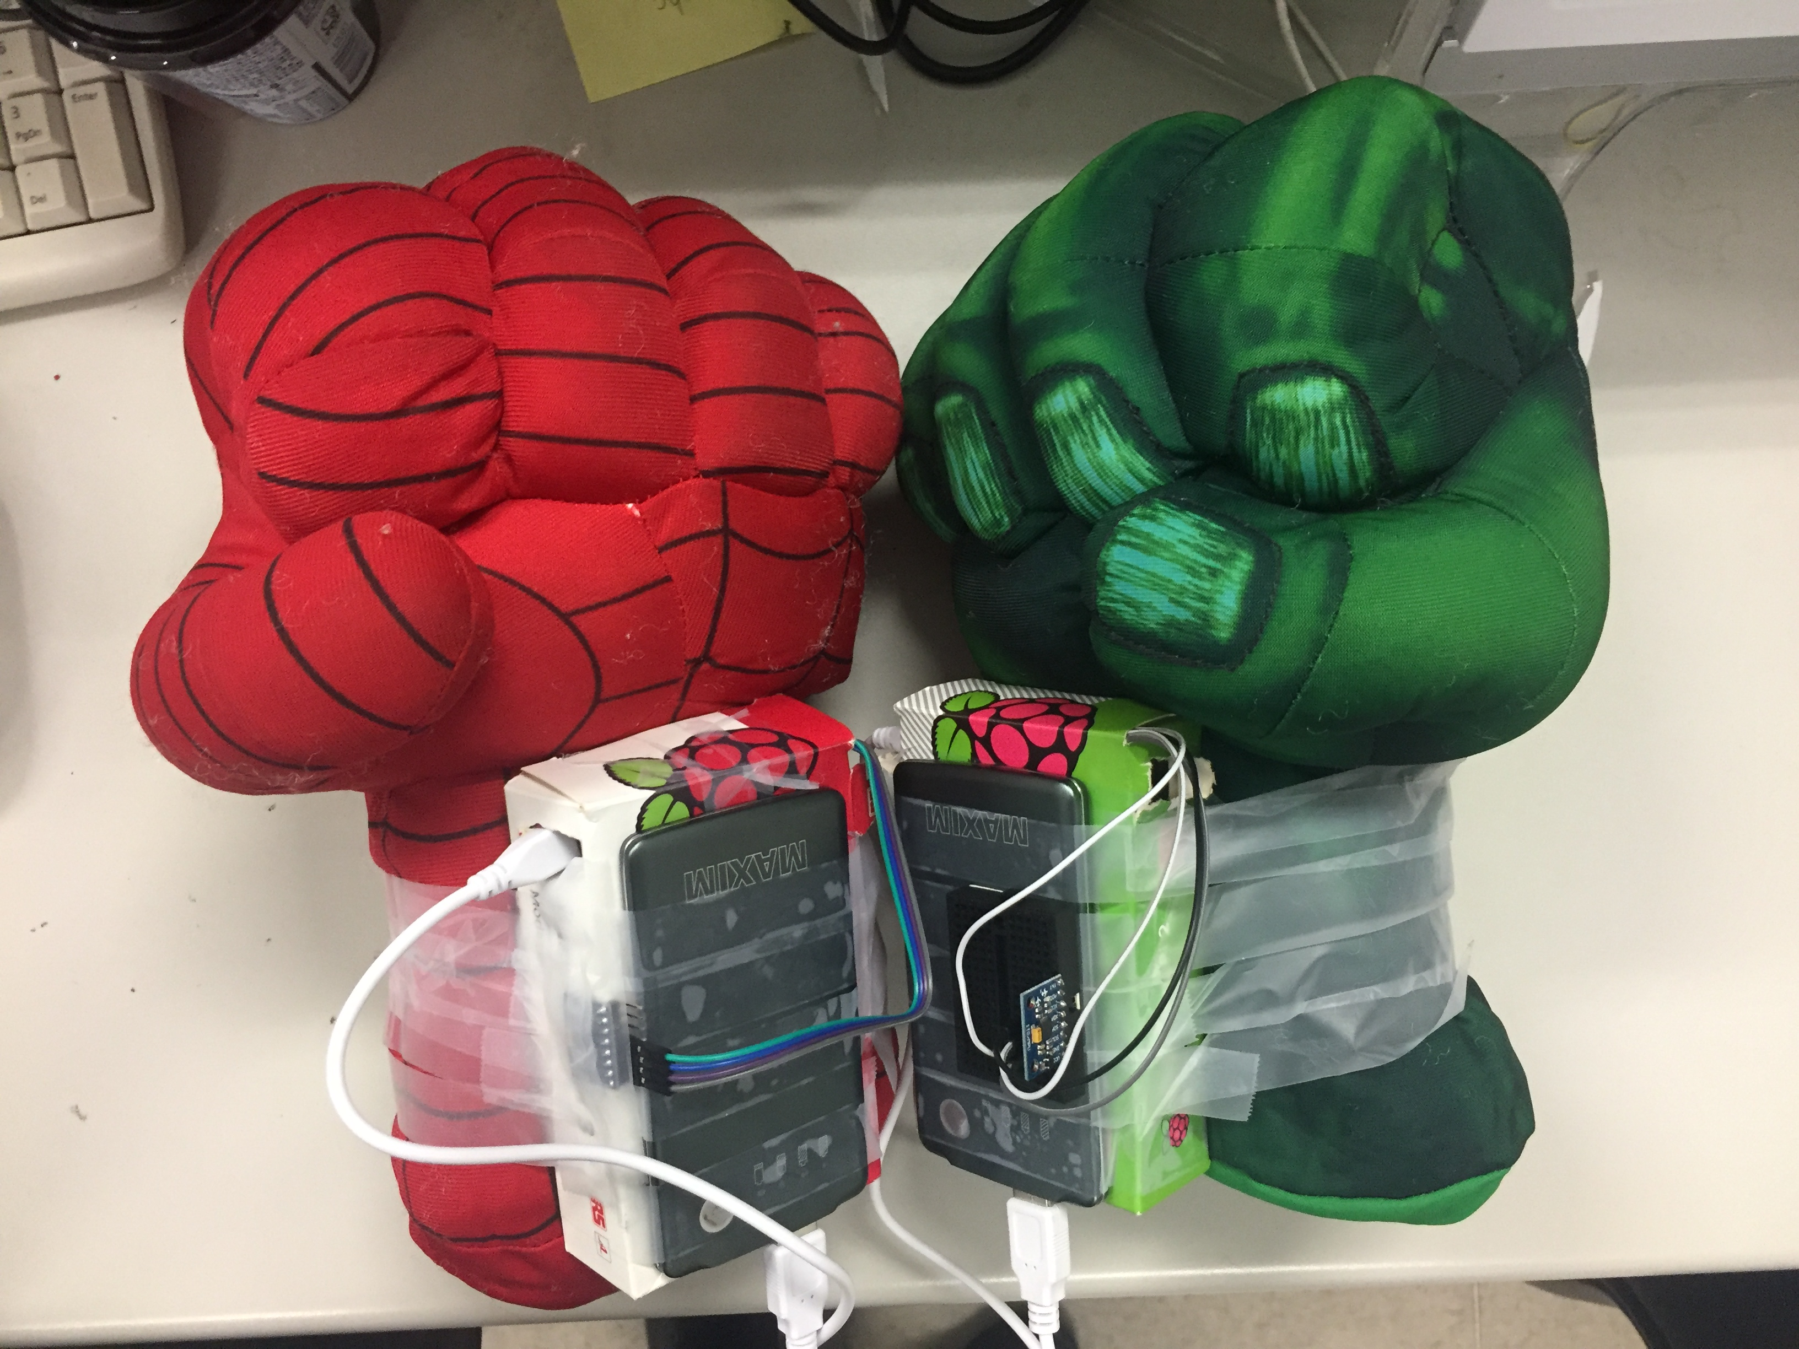
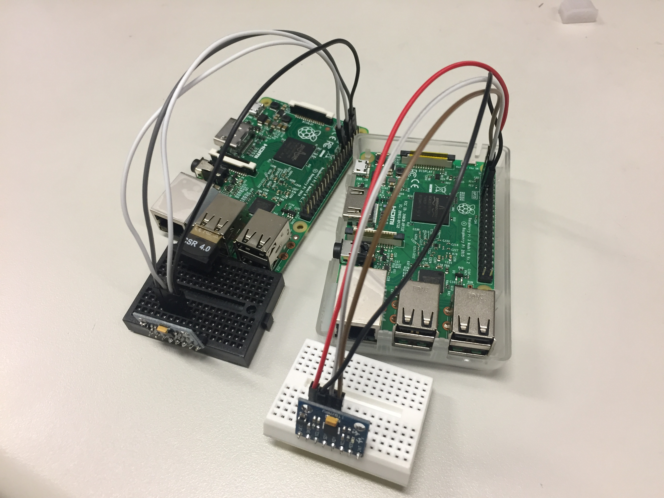
Device

Slide 5
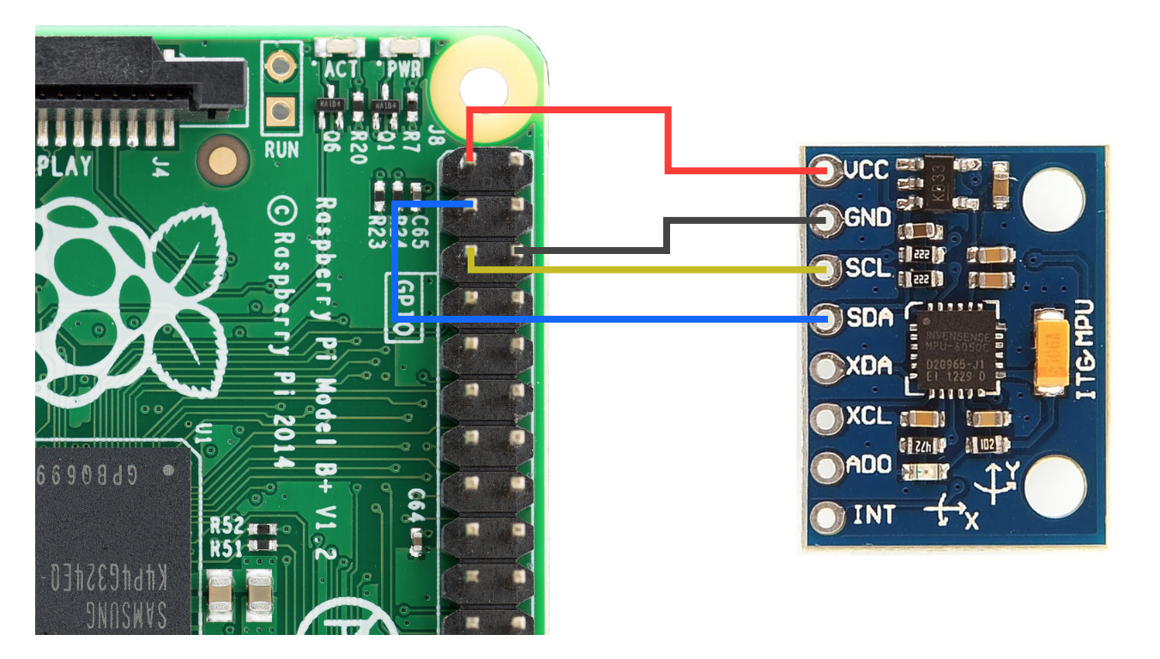
Raspberry Pi & MPU6050
PiBits, Clone from https://github.com/richardghirst/PiBits
I2C connect address: 0x68
YAWPITCHROLL (angle) and REALACCEL (acceleration without gravity)
Thresthold setting by human learning
Pitch angle between (-15~+15), Roll angle edge -45
Acceleration change
De-bounce Setting

Slide 6
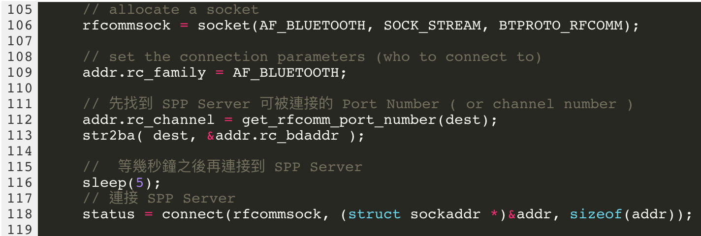
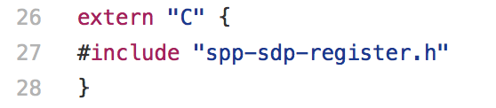
Raspberry Pi & Raspberry Pi
Bluetooth Serial Port Profile (SPP) server and client
Left hand (Client) & Right hand (Server)
Client:
set rfcomm socket
Search for remote RFCOMM port
Connect SPP-server
Server:
Set Bt-dongle Class: 0x1f00
Set SPP_SPEC (SDP Interoperability Requirements)
Wait for RFCOMM connection
Bluetoothctl: pair two devices
Problems: Library Linking Failed? Bluetooth Block?

Slide 7
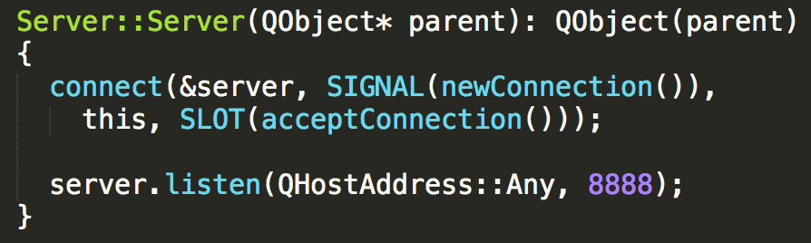
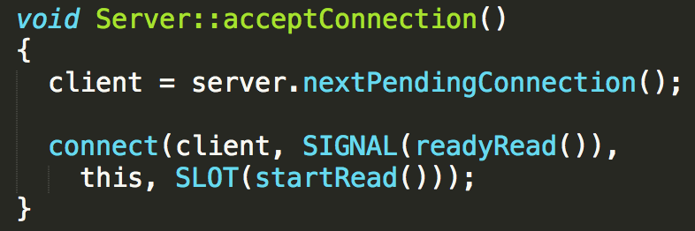
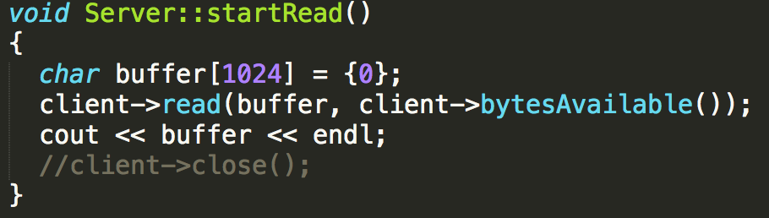
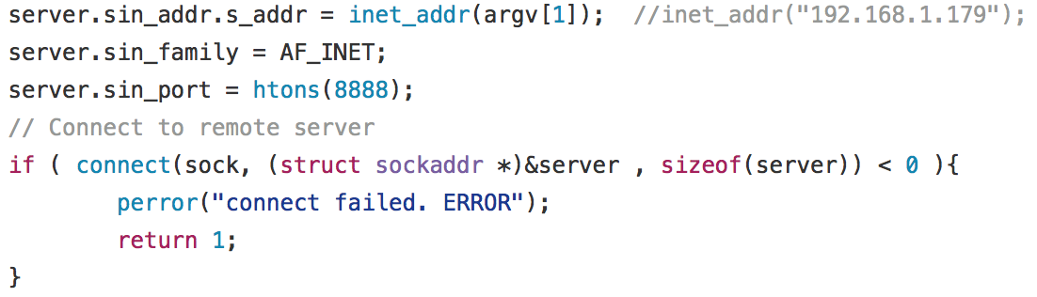
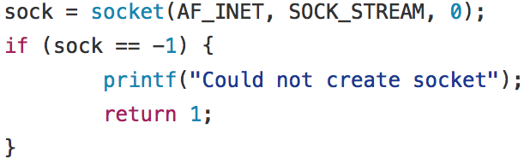
Raspberry Pi & Qt GUI
TCP server (Qt GUI) and Client (Raspberry Pi)
QT TCP Server
Pi TCP Client
Problem: Qt Bluetooth? Dhcp Stop?

Slide 8
Deployment Setting
$ sudo vim /etc/rc.local
Add your script before exit(0)
Default run as root
If your command runs continuously, you must be sure to fork the process by adding “&” to the end of the command
Be sure to reference absolute filenames
For example:
/home/pi/ESL/Pi/MPU6050-right-user2/demo_dmp &
Problems: Network Setting Failed? Dhcp Delay? Rpi 2?

Slide 9
Use Qt and QML for a GUI program
QML for fast GUI design
Combine QML and Qt – Signal Binding
Deploy a Qt program

Slide 10
QML for fast GUI design
Auto-scaling provides by V-Play game engine
QML components tree
Signals and Handlers
State and Transitions
Multimedia (Audio and Video)

Slide 11
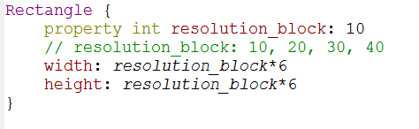
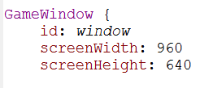
Auto-scaling provides by V-Play game engine
V-Play game engine define several components to provide with auto-scaling of multiple resolutions

Slide 12
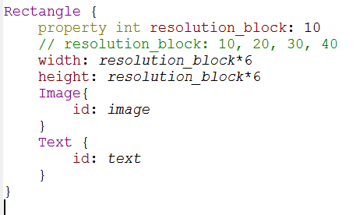
QML Components Tree
Tree Structure:
Rectangle
Image
Text
Parent can modify child’s property
Siblings can access other using “id”
Child can call parent

Slide 13
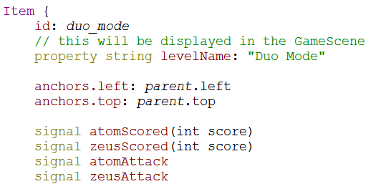
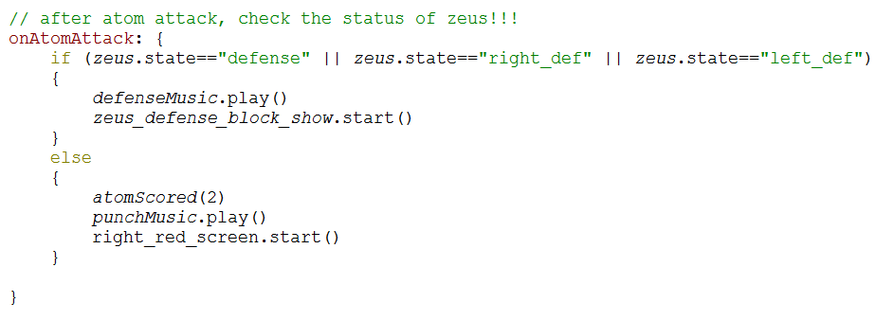
Signals and Handlers
User-defined signals and handlers
Child can call parent’s signal
Parent have it’s handler

Slide 14
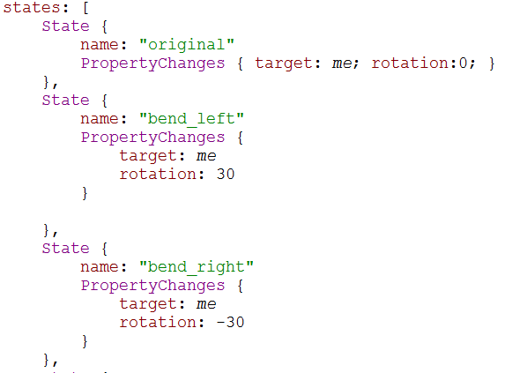
State and Transitions
Define states of components

Slide 15
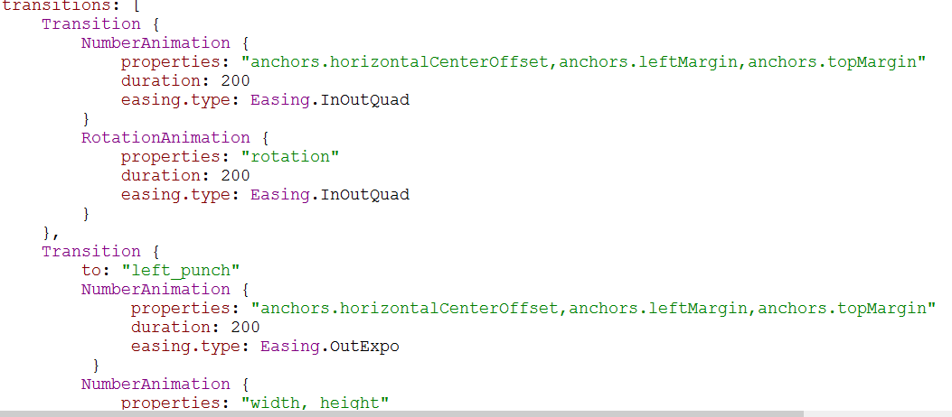
State and Transitions
Define states of components
Add transitions between each state (Some animation)

Slide 16
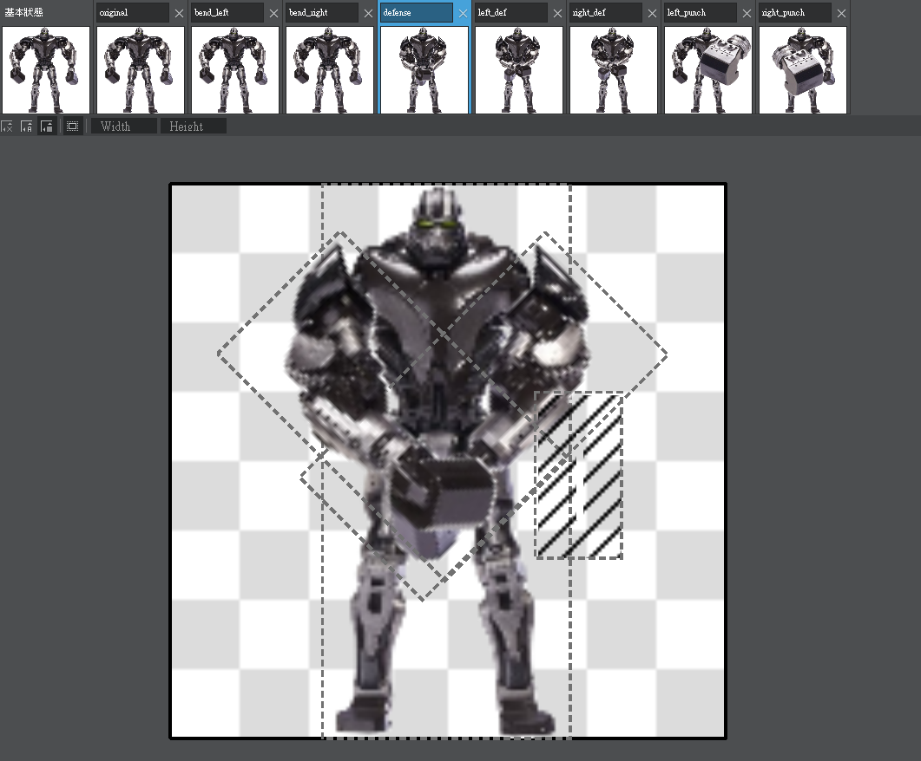
State and Transitions
Define states of components
Add transitions between each state (Some animation)
Qt creator can view several states of component

Slide 17
Multimedia
Component: Audio, SoundEffect, Video
Method: play, paused
Check file encoding for different platforms
For windows 10:
Audio: mp3, wav
SoundEffect: wav
Video: wmv

Slide 18
Use Qt and QML for a GUI program
Qt for cross-device communication
QML for fast GUI design
Combine QML and Qt – Signal Binding
Deploy a Qt program

Slide 19
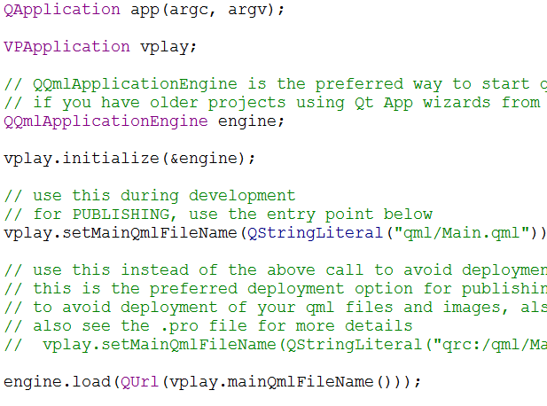
Combine QML and Qt – Signal Binding

Slide 20
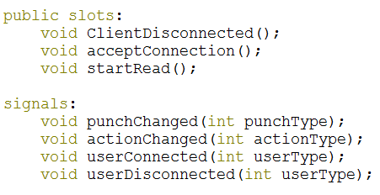
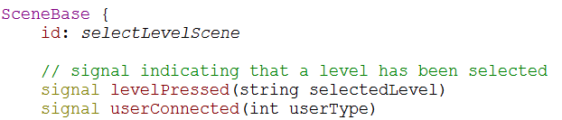
Combine QML and Qt – Signal Binding

Slide 21
Deploy a Qt program
A deploy program is just binary with those libraries
Windows: use windeployqt that comes with qt installer
Caution: After running this program, you need to manually copied the qml folder from original release folder
Linux: use linuxdeployqt as specified in Qt official documents

Slide 22
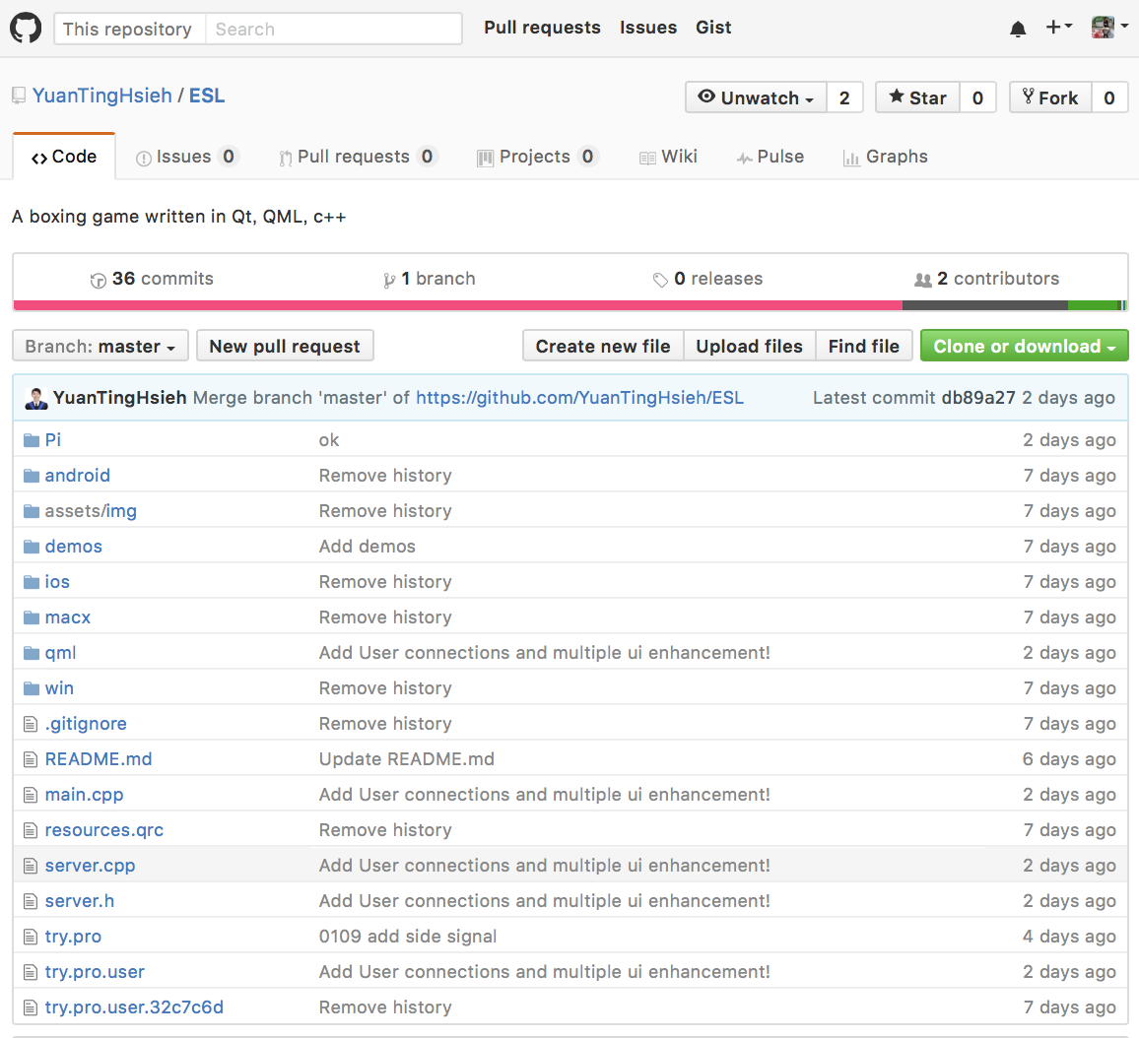
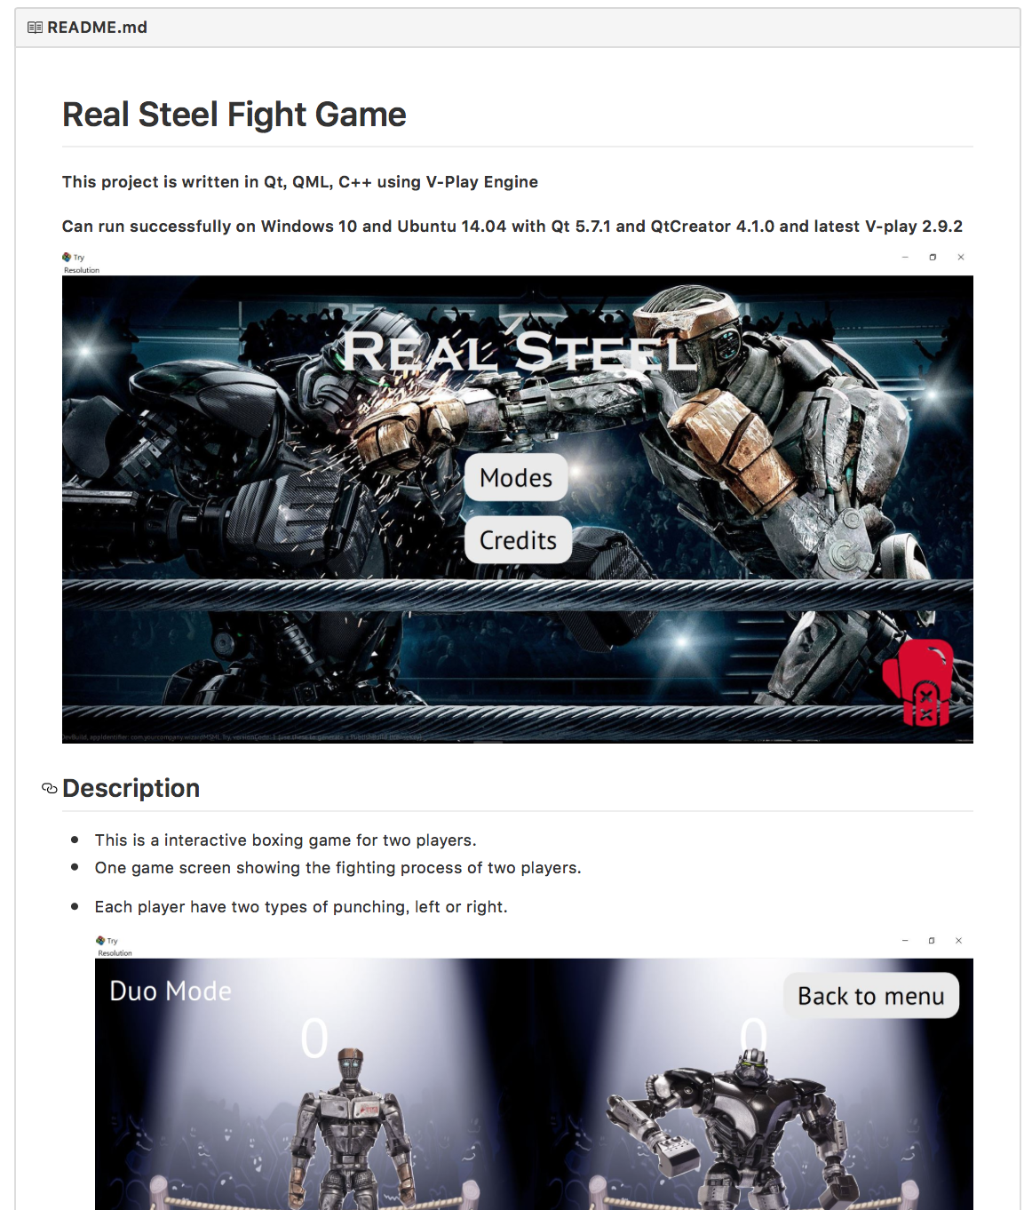
Github
Git clone https://github.com/YuanTingHsieh/ESL

Slide 23
Demo Video

